Slide 1
Welcome to our
Speech and Language Workshop
Wednesday 10th December 2025.
Supporting your child’s language and speech at home.

Slide 2

Aims of the Session
To share with parents and carers strategies and resources we use at school to support your child’s progress with Speech and Language
To demonstrate how a simple activity like making a sandwich at home can support children with Speech and Language needs

Slide 3
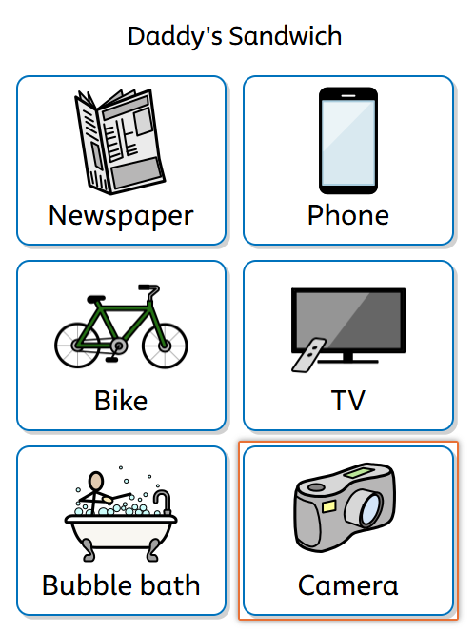
Story sharing.
Daddy’s Sandwich. Pre teaching Vocabulary.

Slide 4


Slide 5

Language through Colour

Slide 6
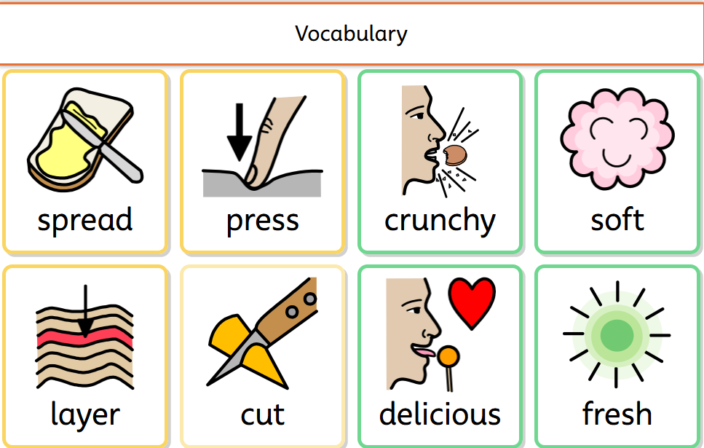
Visuals – dual coded texts

Slide 7
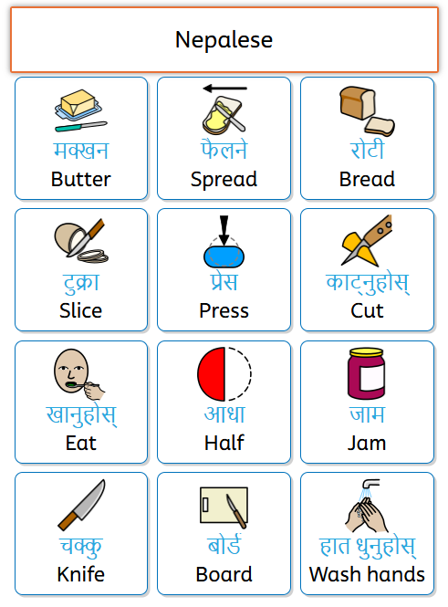
English as an Additional Language

Slide 8
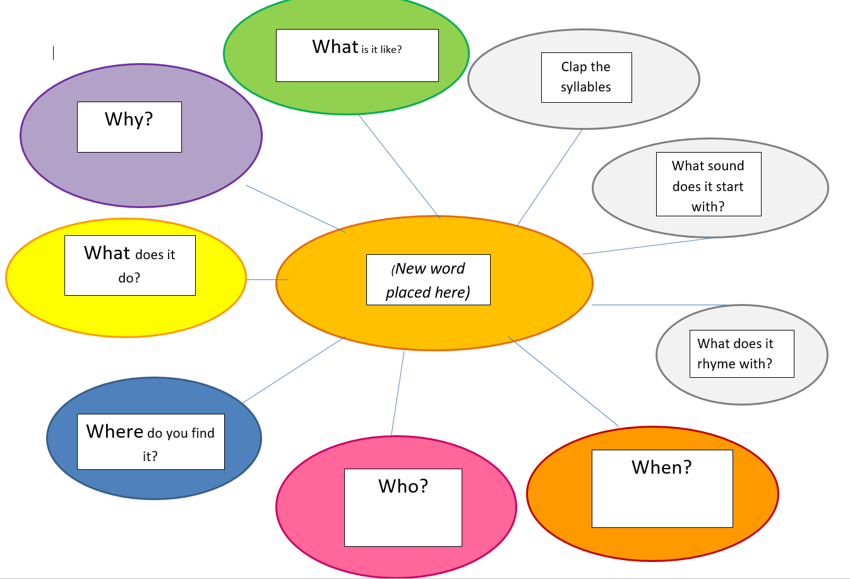

STAR approach

Slide 9
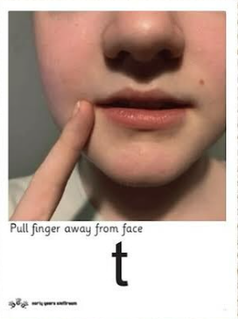
Cued Articulation

Slide 10



Objects of Reference

Slide 11
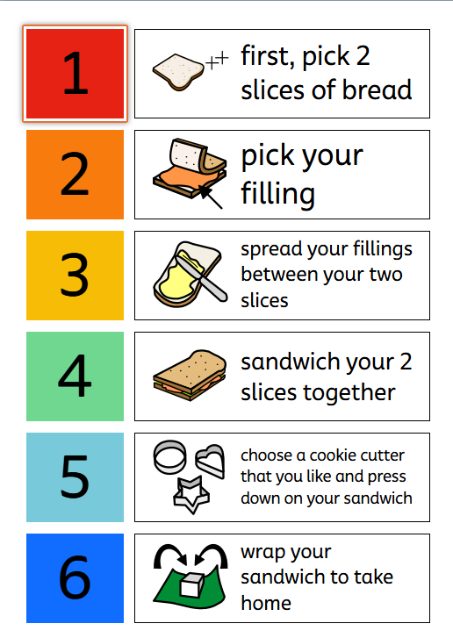
Task Management Boards

Slide 12
Time to make a sandwich with your child.

Slide 13
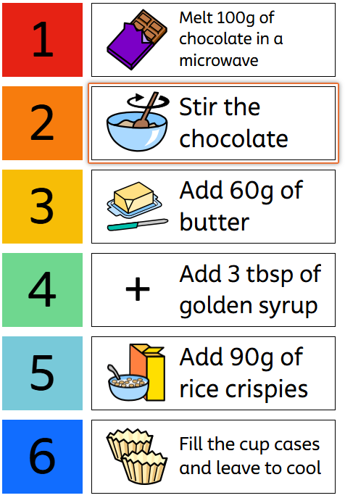

Home task with your child, chocolate crispies

