Slide 1

Welcome to Harcourt Primary School
Believe Achieve Respect
Parent Workshop
19th October 2022

Slide 2
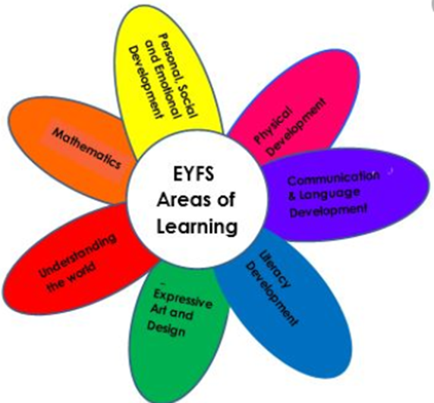
EYFS
…
The children’s learning is based around 7 main areas;
Physical Development
Communication and Language
Personal, Social and Emotional Development
Literacy
Mathematics
Understanding the World
Expressive Art and Design

Slide 3
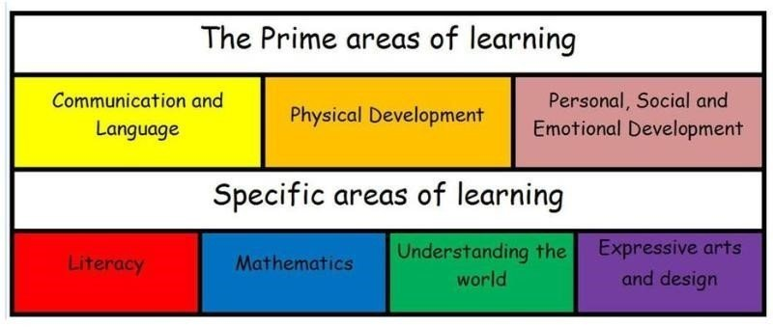
EYFS
…
We also support the children’s learning skills by supporting their ‘Characteristics of Effective Learning’;
Playing and Exploring
Active Learning
Creating and Thinking Critically

Slide 4
EYFS – Reading Early Learning Goal (ELG)
Comprehension ELG
Demonstrate understanding of what has been read to them by retelling stories and narratives using their own words and recently introduced vocabulary;
Anticipate – where appropriate – key events in stories;
Use and understand recently introduced vocabulary during discussions about stories, non-fiction, rhymes and poems and during role-play.
Word Reading ELG
Say a sound for each letter in the alphabet and at least 10 digraphs;
Read words consistent with their phonic knowledge by sound-blending;
Read aloud simple sentences and books that are consistent with their phonic knowledge, including some common exception words.
This also links closely to the Communication and Language expectations at the end of reception.

Slide 5
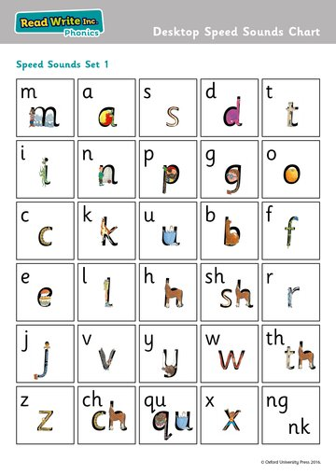
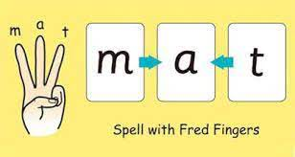
We have daily phonics lessons each morning. We follow the RWI phonics programme. We start by learning the initial ‘Set 1’ sounds.
After we start to learn more sounds, we begin to focus on teaching the children how to blend the sounds together to read simple CVC words such as ‘mat'. This may start by hearing the sounds blended together by an adult to then independently blending sounds to read words.

Slide 6
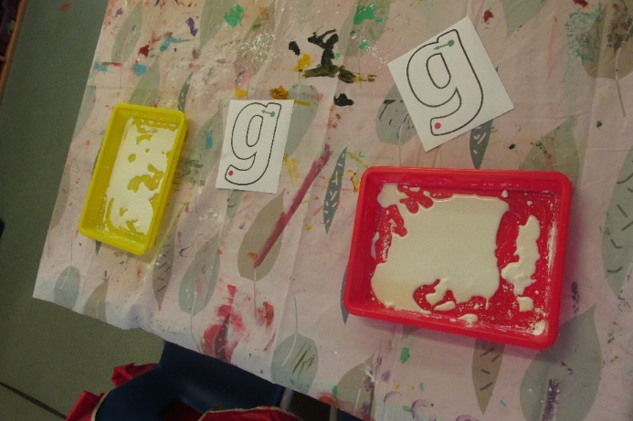
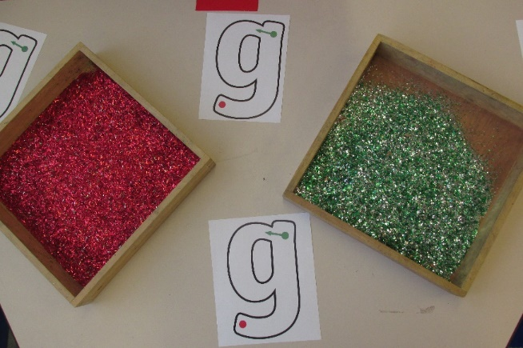
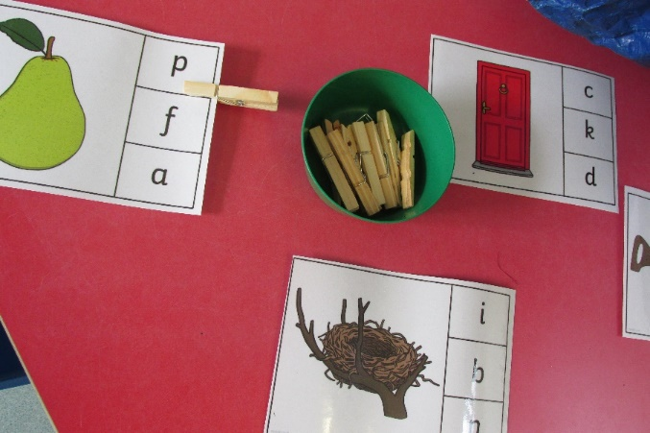
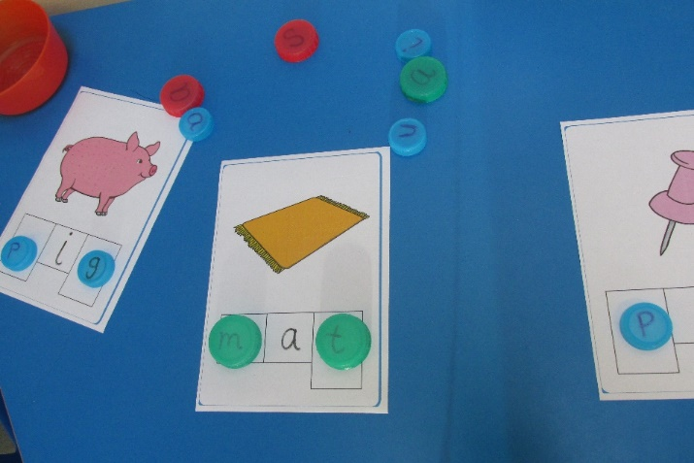
Example of phonics activities:
Letter formation
blending
Initial sounds

Slide 7
Reading in the Early Years Curriculum
In Reception we provide the children with a wide range of opportunities for reading and sharing stories. Some examples include:
Our indoor and outdoor reading corners are areas where children can openly choose to look at and share stories together. We may change books in these areas to reflect our learning.
We share daily stories at the end of the day where we share a wide range of books with the children.
In our provision areas we include opportunities for retelling the stories we have read and role play. For example through using puppets, characters or masks.
We also share stories that are linked to a range of different curriculum areas such as maths, RE and our Jigsaw learning.

Slide 8
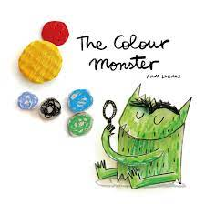
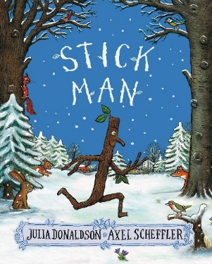



Reading in the Early Years Curriculum
Focus texts each term
Each term we will have two texts that we focus on and explore thoroughly. We will re-read these so we have a good understanding of the texts and are able to retell them. We will discuss and use key vocabulary from the stories. Lots of our learning opportunities and provision will be linked to our focus texts. These will include activities such as role play, retelling using small world characters, art work and writing opportunities. Our key texts will be outlined in our Class Newsletter each term.

Slide 9
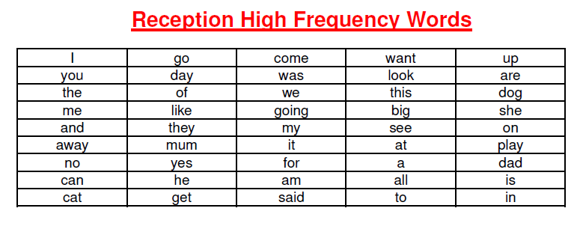
High Frequency Words
The children will have a set of high frequency words to practise at home. Some of these words are decodable which means they can be sounded out. Whereas some of the words are red words which means you cannot use your sounds to read the words and the children have to learn them by sight. They will bring home a set of words that they will need to learn, there are 3 words in each set. They will receive a new set of words once they are able to sight read these words. This means being able to recognise the words correctly without sounding them out.
The most effective way to learn new words is to read them regularly and for a short amount of time. Choose just a few words and focus on them until your child knows them really well. Once your child has learnt these words fluently, they will be given a new set of words to learn as well as recapping their previous set.
They should then know all of these words by the end of Reception.

Slide 10
What you can do at home
Please read daily with your child. This could be their school reading books or sharing books from home together.
Practise the high frequency word cards with your child so that they are able to sight read these words.
Whilst we are learning a new sound a day, the children will come home with a sound sheet to practise identifying and writing the sounds. Please practise these with your child.
Once we have learnt all of the Set 1 sounds we will send home sound flashcards so you can practise identifying the sounds with your children.
The sound book – each week we send home a new sound which will contain a sound that we have learnt so far. For each sound, we are asking you to go on a sound hunt to see what the children can find that begins with the focus sound. This could be at home, on a walk or when they are out and about! Then, record what the children find for each sound either through sticking photographs or writing notes to explain what they have found.

Slide 11

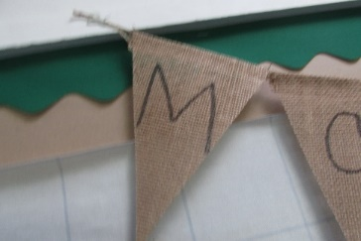

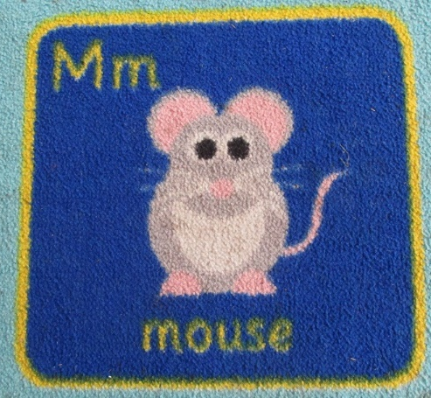
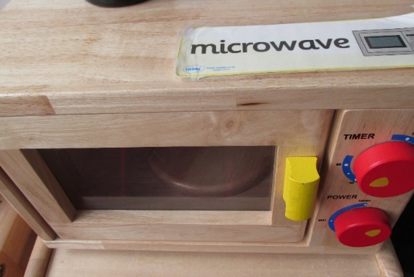
An example of a page for the ‘Sound Book.:
I noticed that mouse begins with a ‘m’
I found a m m m
microwave
I used my sounds to sound out the word m-u-g

Slide 12

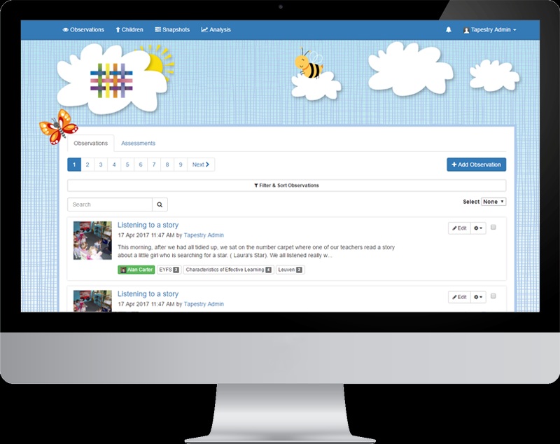
Tapestry
We are lucky to now be using an online Learning Journal to share your child's learning and observations.
This is a valuable tool in being able to track your child's progress. It also enables us to share with you what they have been doing at school.

Slide 13
Early Reading

Slide 14

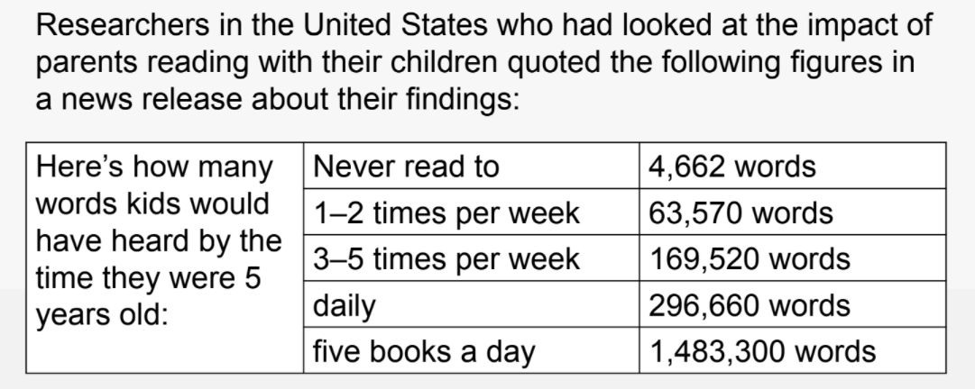
Why is reading so important?
Reading to/with children at age 4-5 every day has a significant positive effect on their reading skills and cognitive skills (i.e., language and literacy, numeracy and cognition) later in life.
Becoming a fluent, able reader will have an impact on everything in life – vocabulary, speech and language, understanding, comprehension, life skills, impacts everything else. If you can read, you open doors to life chances in the future.

Slide 15

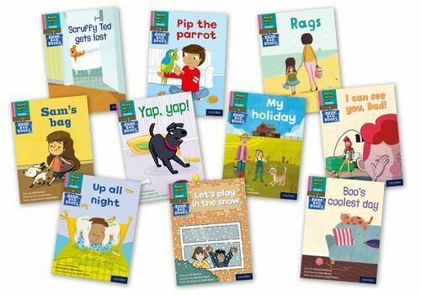
How do we teach reading here at Harcourt?
Daily phonics sessions (whole class and then streamed)
Phonics games and opportunities in class and outside area
Worksheets home
RWI books home and changed twice a week
Library books home
Termly assessments

Slide 16
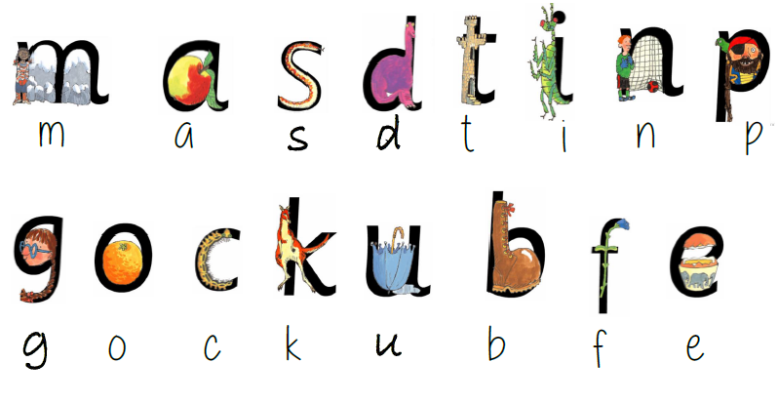



Ways to help at home.
Parent video: How to say the sounds - YouTube

Slide 17
‘Reading’ with very young children.
Getting your child to spot letters they recognise (such as the first letter of their name) in words.
Encouraging your child to read the words on food packets when you are unpacking shopping or cooking.
Singing nursery rhymes and songs together.
Putting books in your child’s toy box
Labelling familiar objects around the house with post-it notes or signs
Reading to your child their favourite books, over and over again.
Buying books as a present.
Your child acting out stories about the books they read, this could be with their toys or as plays for the family.
Listening to audio CDs / E-books.

Slide 18





Top Tips
1 Choose a quiet time
2 Make reading enjoyable
3 Maintain the flow
4 Positive praise
5 Make reading part of the family.

